Slide 1





Explorer GPS Receiver Production Testing & Improvements
Jessica Dudek | Mentor: Nathan Bales
General Dynamics Mission Systems: Scottsdale, AZ
2023 Arizona Space Grant Symposium : April 22, 2023
© 2023 General Dynamics. All rights reserved.

Slide 2


Project Description
ASU Space Grant Industry partnership with General Dynamics Mission Systems
Hayden Building - 8201 E McDowell Rd, Scottsdale, AZ 85257
Engineering intern
SAES (Space Avionics & Electronics Solutions) Systems Engineering team
Engineering Intern → Mechanical Engineering focus
Project: Explorer GPS / Viceroy®
© 2023 General Dynamics. All rights reserved.

Slide 3
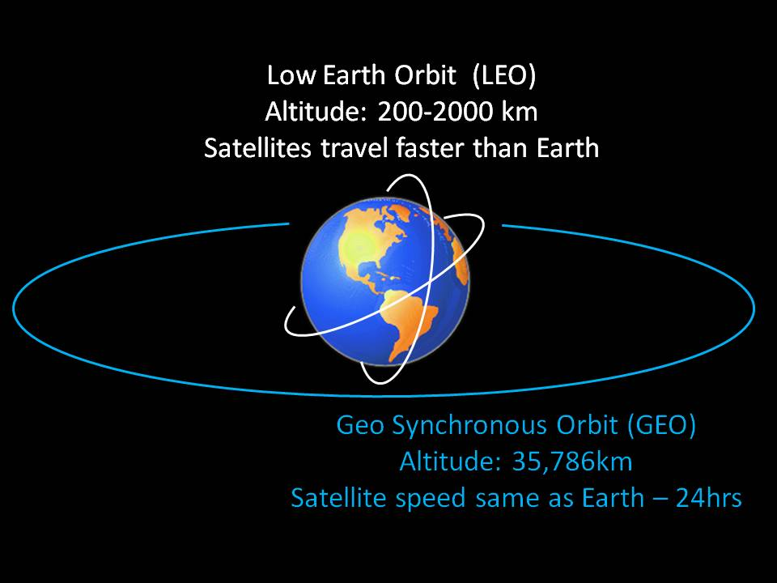
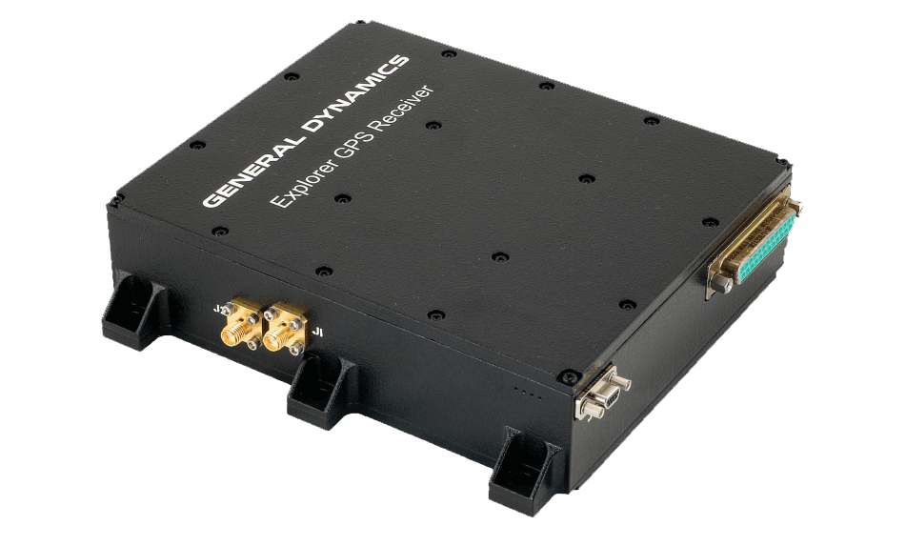
What is Explorer GPS?
Explorer – Program name (formerly known as Viceroy®)
GPS – Global Positioning System
Receiver – Picks up either the electric component or the magnetic component of electromagnetic signal depending on its antenna design [2].
Explorer GPS Receiver
Spaceborne receiver designed and produced by General Dynamics Mission Systems
Source: https://spacedge.academy/course/view.php?id=81
© 2023 General Dynamics. All rights reserved.

Slide 4
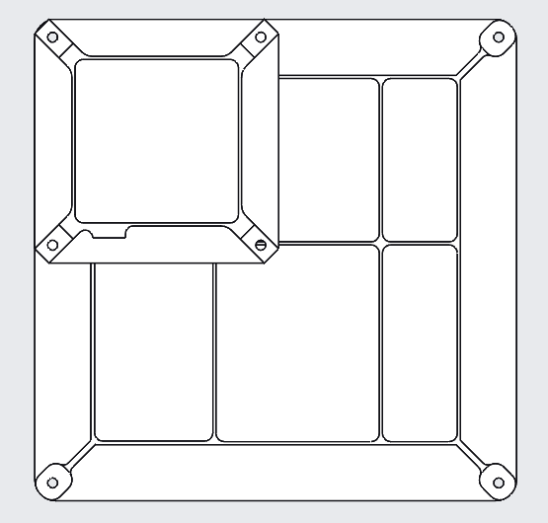
Why Does it Matter?
Challenges
GPS receiver for spacecraft on orbit
Computes position, velocity, and time information for Low Earth Orbit (LEO) and Geostationary Earth Orbit (GEO) [1].
Increased volume in customer orders → increased production & testing
Legacy program with testing hardware and procedures designed for previous generations of the unit
New ASU Space Grant x industry partnership
LEO Antenna
GEO Antenna
© 2023 General Dynamics. All rights reserved.

Slide 5
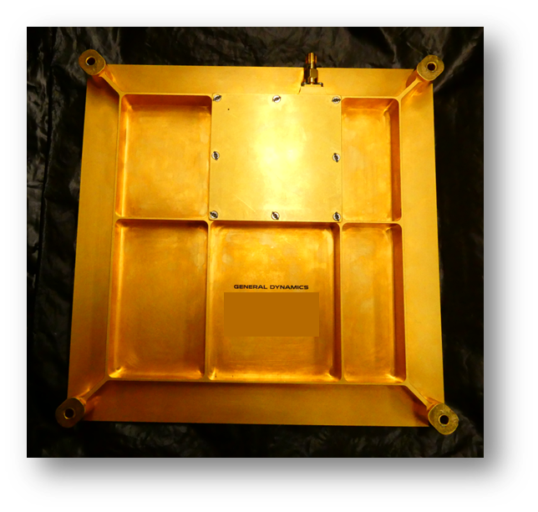
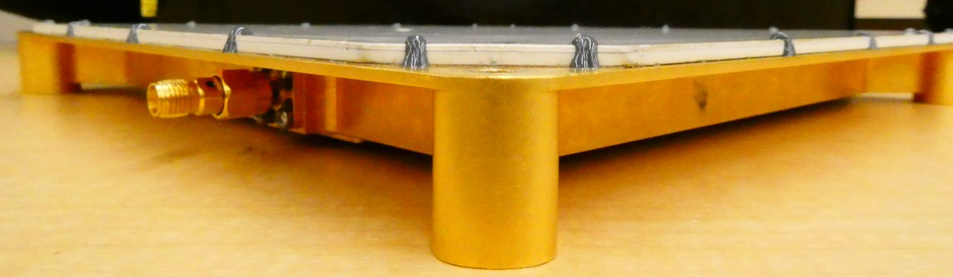
Overview of Projects
Vibration Cube Analysis
Antenna Test Fixture Modifications
Pyroshock Testing Procedure & Qualification Report
Vibration Cube Pattern Configurations
GEO Antenna Engineering Development Unit (EDU)
© 2023 General Dynamics. All rights reserved.

Slide 6
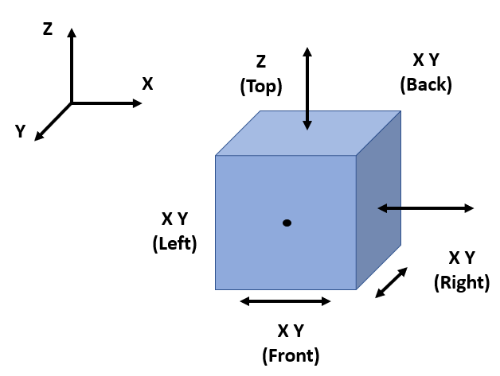
Vibration Cube Analysis
Constraints on Testing
# of Test Faces on Cube = 5
# of Testing Rooms = 4
# of GDMS Test Employees
Maximum # of Trials per Year = 24
 |  | Annual Viceroy® Forecast
# Of Vibration Tests |  | 24 | 25 | 26 | 27 | 28 | 29 | 30 | 31 | 32 | 33 | 34 | 35 | 36 | 37 | 38 | 39 | 40 | 41 | 42 | 43 | 44 | 45 | 46 | 47 | 48 | 49 | 50
 | 2 | 12 | 13 | 13 | 14 | 14 | 15 | 15 | 16 | 16 | 17 | 17 | 18 | 18 | 19 | 19 | 20 | 20 | 21 | 21 | 22 | 22 | 23 | 23 | 24 | 24 | 25 | 25
 | 3 | 8 | 9 | 9 | 9 | 10 | 10 | 10 | 11 | 11 | 11 | 12 | 12 | 12 | 13 | 13 | 13 | 14 | 14 | 14 | 15 | 15 | 15 | 16 | 16 | 16 | 17 | 17
 | 4 | 6 | 7 | 7 | 7 | 7 | 8 | 8 | 8 | 8 | 9 | 9 | 9 | 9 | 10 | 10 | 10 | 10 | 11 | 11 | 11 | 11 | 12 | 12 | 12 | 12 | 13 | 13
 | 5 | 5 | 5 | 6 | 6 | 6 | 6 | 6 | 7 | 7 | 7 | 7 | 7 | 8 | 8 | 8 | 8 | 8 | 9 | 9 | 9 | 9 | 9 | 10 | 10 | 10 | 10 | 10
© 2023 General Dynamics. All rights reserved.

Slide 7
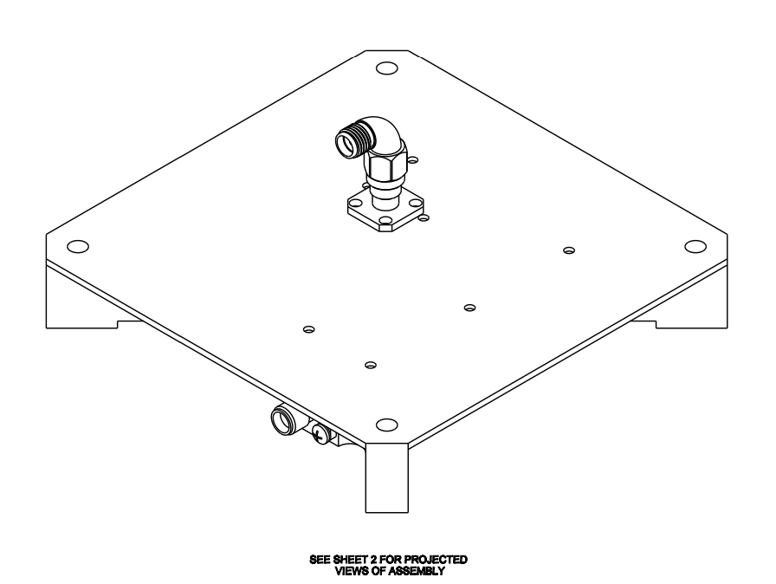
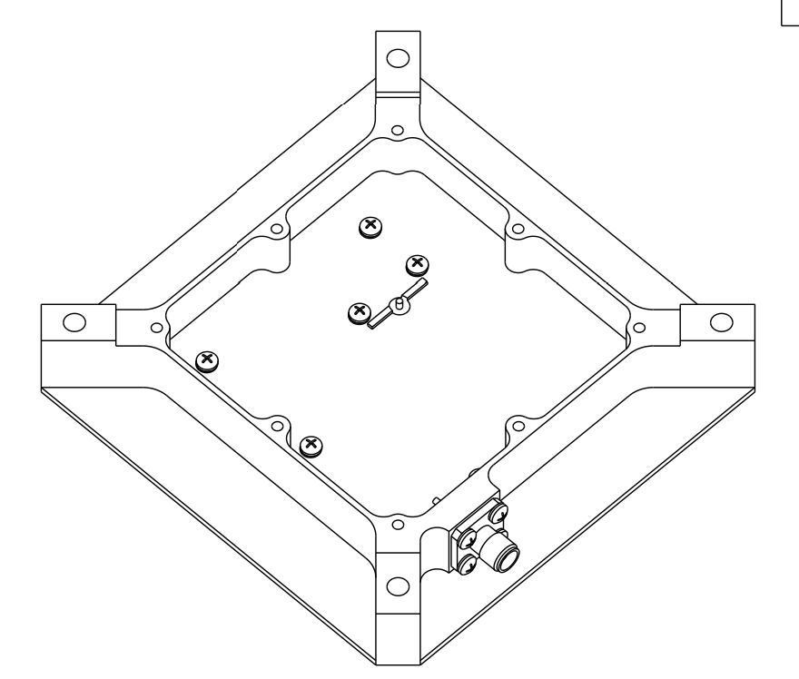
Antenna Test Fixture Modifications
Problem
Current LEO antenna fixture was bulky and did not hold the circuit board in the correct position
Project Purpose
Model the existing antenna fixture in CREO Parametric to manufacture more fixtures and reference in future bill of materials (BOM)
Challenges
No prior experience with Creo
Results
New part designed and released in General Dynamics Mission Systems product database
Fixture BOM complete and ready for production
LEO Antenna Test Fixture
© 2023 General Dynamics. All rights reserved.

Slide 8
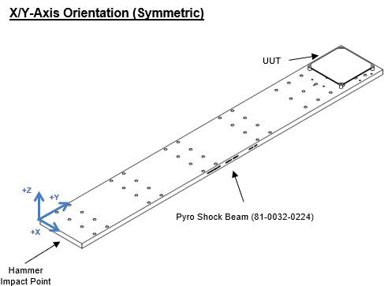
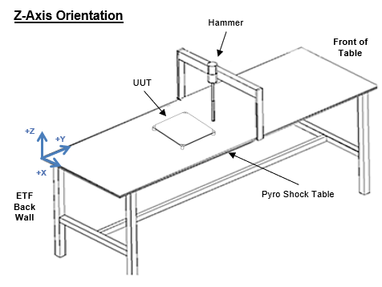
Pyroshock Beam Modifications, Testing Procedure, and Qualification Report
Problem
Shock testing procedure for GEO antenna does not exist
Full Qualification report for GEO antenna does not exist
Project Purpose
Create the first full qualification report for the GEO antenna containing shock, environmental, vibration, and thermal results
Challenges
Tuning difficulties with mechanical impulse pyroshock simulator (MIPS) table & pyroshock beam
New testing configuration on pyroshock beam for GEO chassis
© 2023 General Dynamics. All rights reserved.

Slide 9
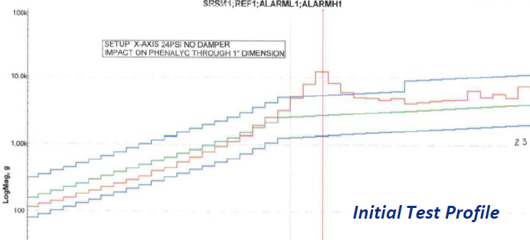
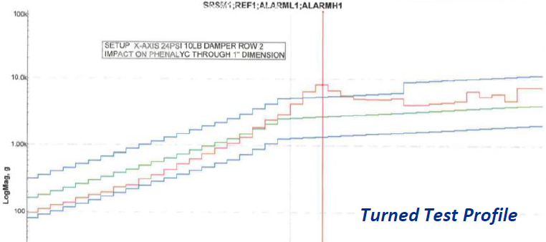
Pyroshock Beam Modifications, Testing Procedure, and Qualification Report
Results
Redesigned pyroshock test beam to be within target frequency range
Manufactured new pyroshock testing beam and Z-axis orientation bracket
Achieved qualified data for Engineering Development Unit (EDU) of the Explorer GEO Antenna
© 2023 General Dynamics. All rights reserved.

Slide 10
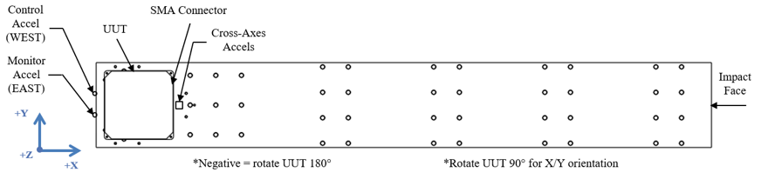
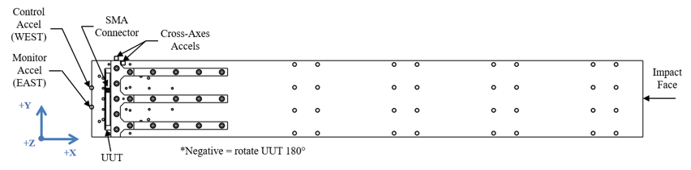
Pyroshock Beam Modifications, Testing Procedure, and Qualification Report
X/Y Orientation of Unit on Pyro Shock Beam
Results Continued
Wrote and executed GEO qualification shock testing procedure
Integrated shock testing results into final qualification report
Z Orientation of Unit on Pyro Shock Beam
© 2023 General Dynamics. All rights reserved.

Slide 11
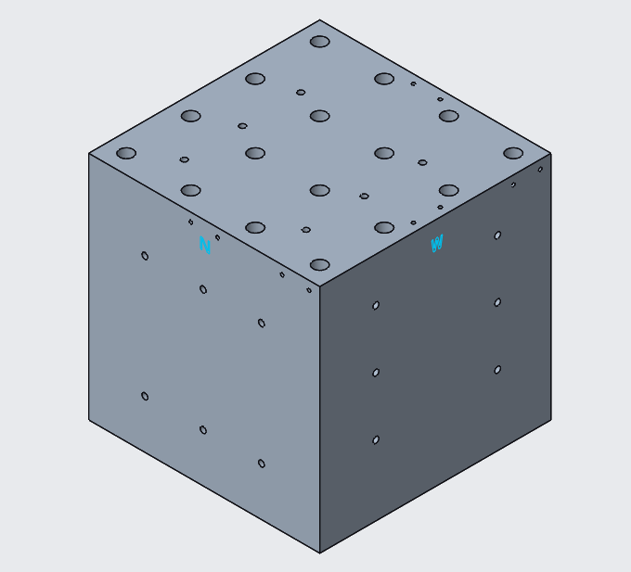
Vibration Cube Pattern Configurations
Problem
Difficult to locate unit hole pattern when setting up vibration test
Project Purpose
Reduce vibration testing time
Prevent mounting mistakes
Challenges
Multiple unit patterns = Mounting hole interference
Vibration Cube
© 2023 General Dynamics. All rights reserved.

Slide 12
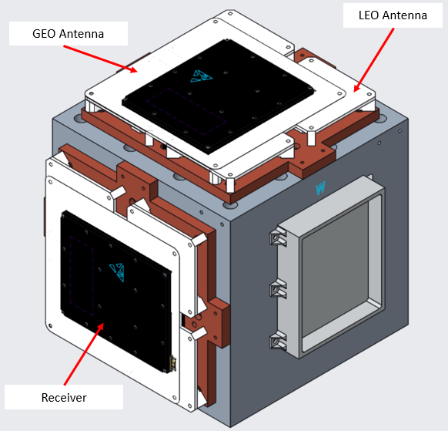
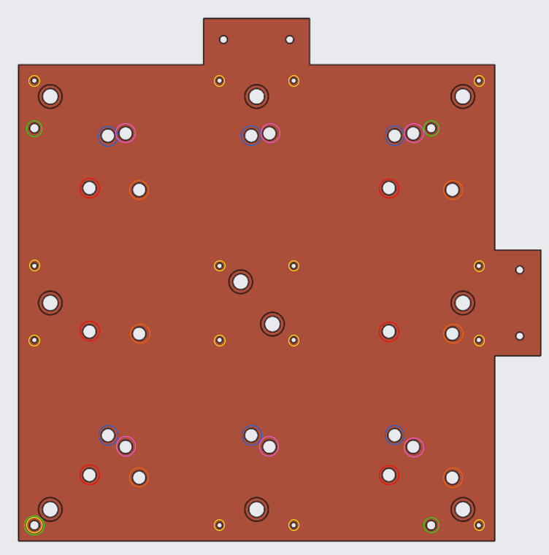
Vibration Cube Pattern Configurations
Color Legend
Red = Receiver Orientation 1
Yellow = LEO Antenna
Green = GEO Antenna
Blue = Receiver Orientation 2
Pink = Explorer+ Orientation 1
Orange = Explorer+ Orientation 2
Results
Vibration Cube - All Units Mounted
Paint Configuration for All Units
© 2023 General Dynamics. All rights reserved.

Slide 13
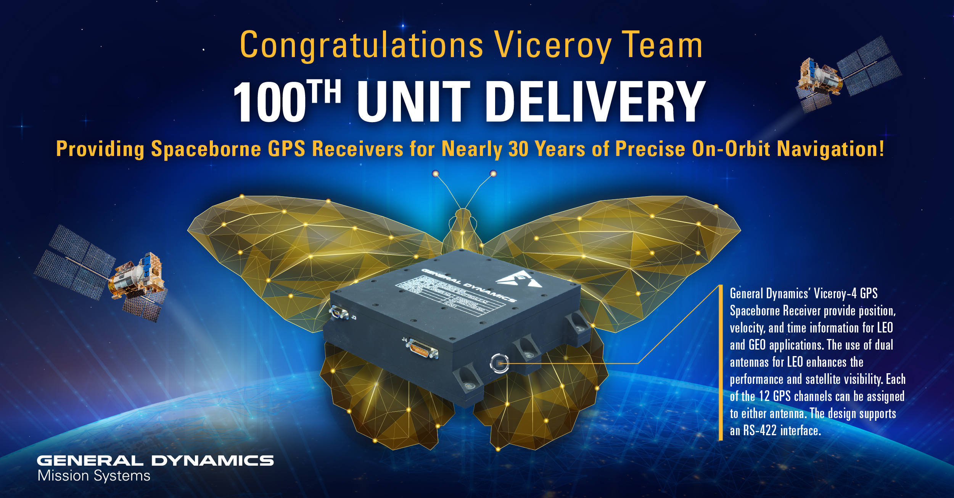
Conclusion
Future Work
Experience working with space hardware and electronics
Low-level understanding of RF communication systems
Hands on vibration & shock testing experience
Learned how to use Creo
Completed 4 General Dynamics Mission Systems Projects
Continue supporting Explorer GPS & Viceroy® program developments
Implement testing hardware modifications
Create and release new parts in product management system
© 2023 General Dynamics. All rights reserved.

Slide 14
Acknowledgements
Special thanks to Nathan Bales, Courtney Suarez, and Kateri Rosedale for sharing all their knowledge and kindness throughout my internship experience at General Dynamics Mission Systems. I would also like to thank Arizona State University’s Space Grant program leaders Scott Smas, Desiree Crawl, and Dr. Thomas Sharp for having the confidence to allow me to pilot this internship experience. Thank you, Arizona Space Grant Consortium for this opportunity.
© 2023 General Dynamics. All rights reserved.

Slide 15

Thank You
© 2023 General Dynamics. All rights reserved.

Slide 16
References
[1] Explorer GPS receiver. General Dynamics Mission Systems. (n.d.). Retrieved March 29, 2023, from https://gdmissionsystems.com/products/communications/spaceborne-communications/spaceborne-gps-receivers/explorer-gps-receiver
[2] NASA. (n.d.). Basics of Space Flight. NASA. Retrieved March 28, 2023, from https://www2.jpl.nasa.gov/basics/bsf10-1.php
© 2023 General Dynamics. All rights reserved.

